Slide 1
Fraud Email Detection
Jannatul Tajrin Shammi-14301084
Fabiha Neaz-14301031
Farzana Yeasmin- 14301111
Sharmin Islam-14101127

Slide 2
Contributions
Dataset Analysis- Fabiha Neaz
Algorithm Analysis- Farzana Yeasmin
Coding and Environment Setup-Sharmin Islam
Result Analysis, Presentation making and Report writing- Jannatul Tazrin Shammi.

Slide 3
Goals of the project
The goal of this project is to find the person who is committing fraud based on their emails.
POI is a person who has been indicted, settled without admitting the guilt without testified in exchange for immunity.
Our goal is to check our predicted POI against actual POI in the dataset to evaluate our prediction.

Slide 4
Types of fraud email
Spoofing
Phishing for data
Bogus offer
Request for help

Slide 5
Areas Covered
Data Mining
Data Analytics
Social Computing
Prediction of fraudulent
Risk factor analysis

Slide 6
Dataset Analysis
1st column contains the locations of the emails, 2nd column contains the emails (data)
The input column will be column 2 (containing the emails)
There is no output column.
Each row of column 1 contains the location of the mail of the corresponding row of column 2
The Dataset has some nan values.

Slide 7
Algorithms Available
Naive Bayes
Decision Tree Algorithm
SVM
Random forest algorithm
KNN Algorithm
Algorithm Use : All these algorithms will be attempted. Among them we will work on the one whose accuracy level will be higher.

Slide 8
Explanation about code
Resources are available in Internet
Found similar git hub code
Library: Panda, Sklearn, numpy,pickle, plotly
Our coding part is under development.

Slide 9
Results
We got 0.83962 (83%) accuracy by using Decision Tree Algorithm.
By using KNN algorithm we found out the fraud emails and emails which is
similar to the fraud emails.
We plotted graph of POI and Non-POI employees vs. the emails they send.
We used some formulas to detect the true positive emails(emails which are
positive and detected as positive), true negative false positive and false
negative emails.

Slide 10
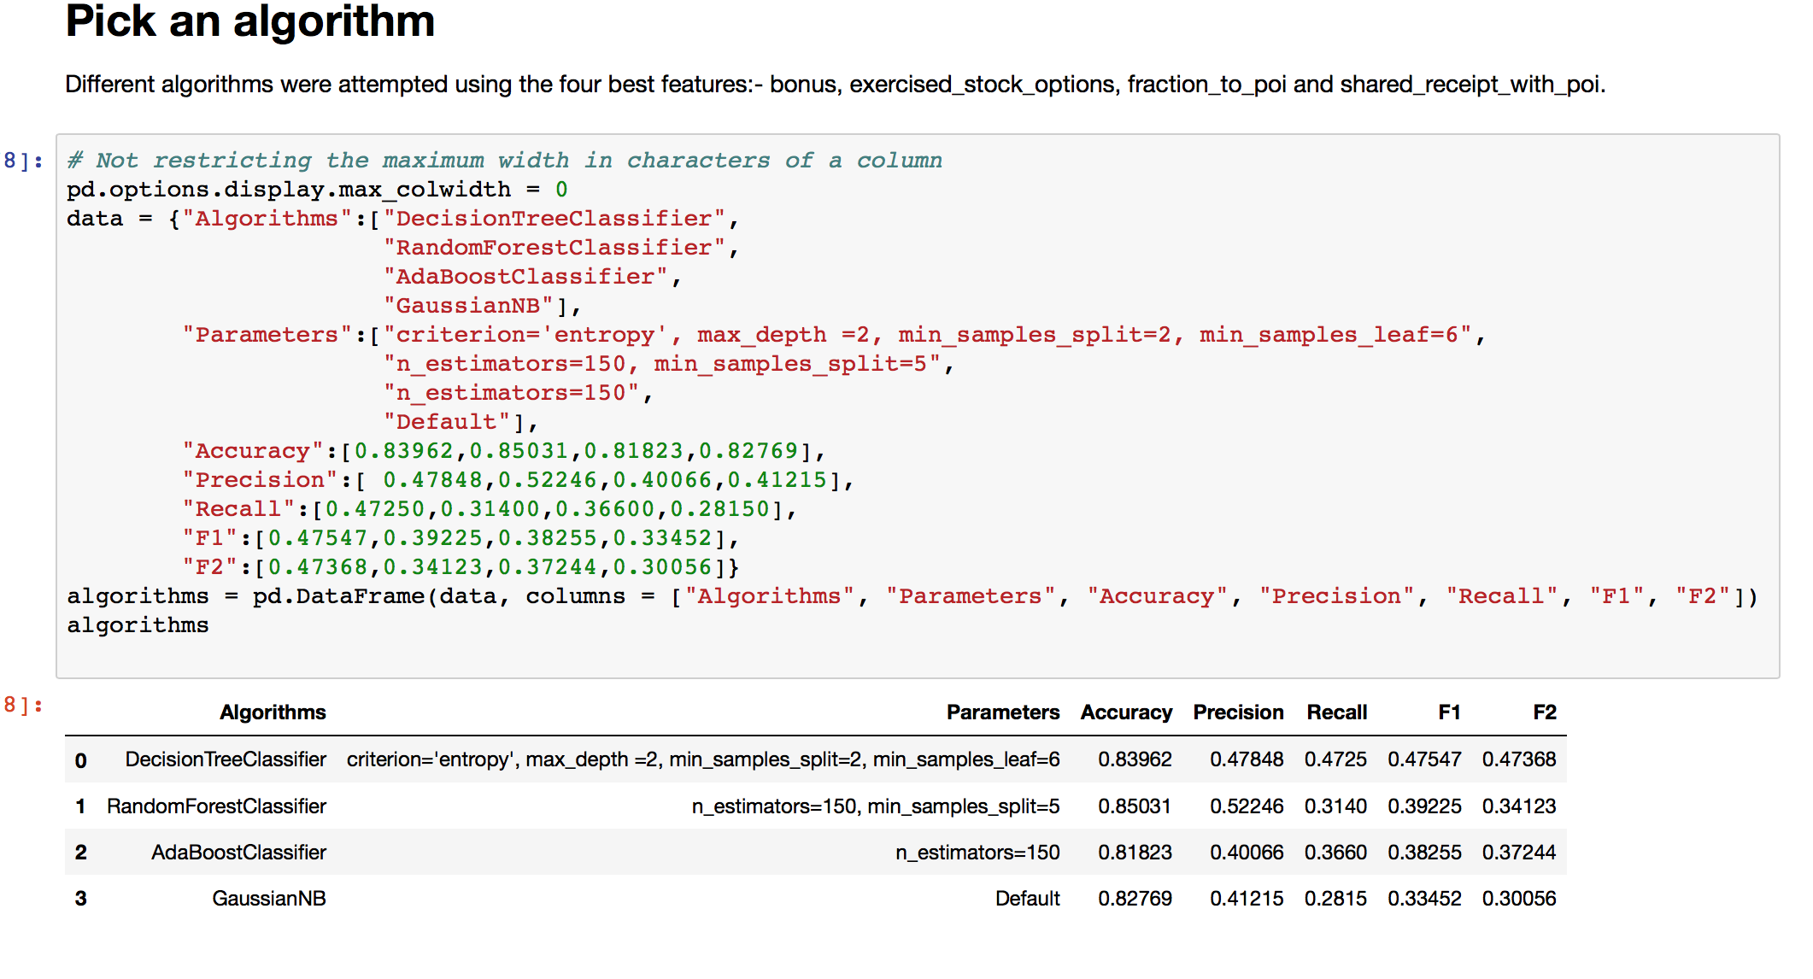
Accuracy levels

Slide 11
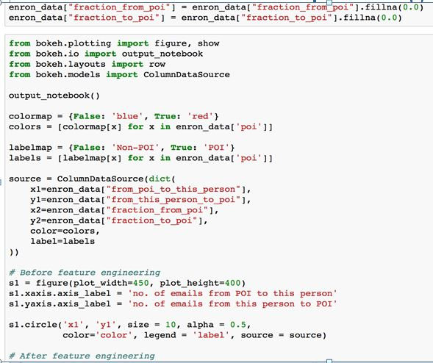
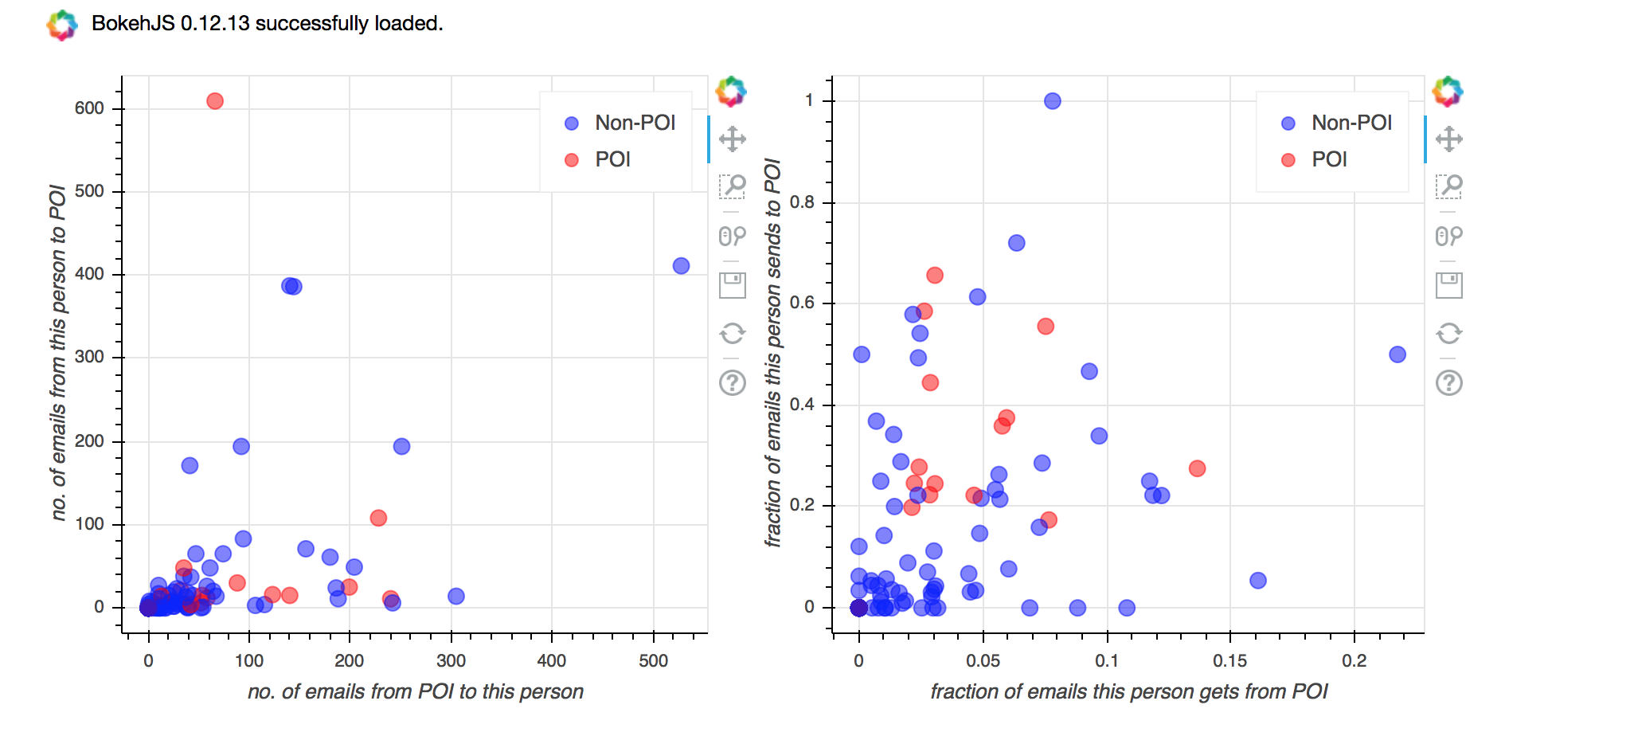
Plotted graph

Slide 12
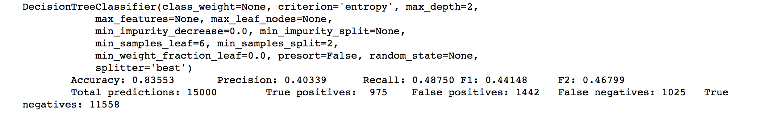
Final Result

Slide 13
References
Dataset:
https://www.kaggle.com/wcukierski/enron-email-dataset

